Slide 1
Cross correlations (scatter matrix)
 | Sum of UNITS | Sum of Field_sourceCol_F_value_A2 | Count of VEND | Sum of DOLLARS | Count of ITEM | Sum of Field_sourceCol_D_value_2 | Sum of Field_sourceCol_D_value_1 | Sum of Field_sourceCol_D_value_0 | Sum of Field_sourceCol_F_value_A+ | Sum of Field_sourceCol_F_value_C | Sum of Field_sourceCol_F_value_B | Sum of Field_sourceCol_F_value_A | Sum of Field_sourceCol_F_value_NONE | Sum of PR
Sum of UNITS | 1 | 0.2191 | 0.9919 | 0.9851 | 0.9919 | 0.2163 | 0.2067 | 0.9839 | -0.0322 | 0.026 | 0.0303 | 0.2191 | 0.9883 | 0.3872
Sum of Field_sourceCol_F_value_A2 | 0.2191 | 1 | 0.224 | 0.2575 | 0.224 | 0.0865 | 0.5643 | 0.1601 | 0.202 | 0.1393 | 0.1392 | 1 | 0.1471 | 0.4751
Count of VEND | 0.9919 | 0.224 | 1 | 0.9879 | 1 | 0.2287 | 0.1935 | 0.9933 | -0.034 | 0.0117 | 0.0441 | 0.224 | 0.9961 | 0.3634
Sum of DOLLARS | 0.9851 | 0.2575 | 0.9879 | 1 | 0.9879 | 0.2092 | 0.211 | 0.9797 | -0.0222 | 0.0293 | 0.0654 | 0.2575 | 0.9803 | 0.3687
Count of ITEM | 0.9919 | 0.224 | 1 | 0.9879 | 1 | 0.2287 | 0.1935 | 0.9933 | -0.034 | 0.0117 | 0.0441 | 0.224 | 0.9961 | 0.3634
Sum of Field_sourceCol_D_value_2 | 0.2163 | 0.0865 | 0.2287 | 0.2092 | 0.2287 | 1 | -0.0982 | 0.2031 | -0.0464 | 0.0083 | 0.0413 | 0.0865 | 0.2245 | 0.286
Sum of Field_sourceCol_D_value_1 | 0.2067 | 0.5643 | 0.1935 | 0.211 | 0.1935 | -0.0982 | 1 | 0.0859 | 0.1475 | 0.2256 | 0.2091 | 0.5643 | 0.143 | 0.5233
Sum of Field_sourceCol_D_value_0 | 0.9839 | 0.1601 | 0.9933 | 0.9797 | 0.9933 | 0.2031 | 0.0859 | 1 | -0.0501 | -0.0147 | 0.0191 | 0.1601 | 0.9953 | 0.2993
Sum of Field_sourceCol_F_value_A+ | -0.0322 | 0.202 | -0.034 | -0.0222 | -0.034 | -0.0464 | 0.1475 | -0.0501 | 1 | 0.0164 | -0.0317 | 0.202 | -0.0571 | 0.1857
Sum of Field_sourceCol_F_value_C | 0.026 | 0.1393 | 0.0117 | 0.0293 | 0.0117 | 0.0083 | 0.2256 | -0.0147 | 0.0164 | 1 | 0.1068 | 0.1393 | -0.0249 | 0.2315
Sum of Field_sourceCol_F_value_B | 0.0303 | 0.1392 | 0.0441 | 0.0654 | 0.0441 | 0.0413 | 0.2091 | 0.0191 | -0.0317 | 0.1068 | 1 | 0.1392 | 0.0003 | 0.1313
Sum of Field_sourceCol_F_value_A | 0.2191 | 1 | 0.224 | 0.2575 | 0.224 | 0.0865 | 0.5643 | 0.1601 | 0.202 | 0.1393 | 0.1392 | 1 | 0.1471 | 0.4751
Sum of Field_sourceCol_F_value_NONE | 0.9883 | 0.1471 | 0.9961 | 0.9803 | 0.9961 | 0.2245 | 0.143 | 0.9953 | -0.0571 | -0.0249 | 0.0003 | 0.1471 | 1 | 0.3234
Sum of PR | 0.3872 | 0.4751 | 0.3634 | 0.3687 | 0.3634 | 0.286 | 0.5233 | 0.2993 | 0.1857 | 0.2315 | 0.1313 | 0.4751 | 0.3234 | 1

Slide 2
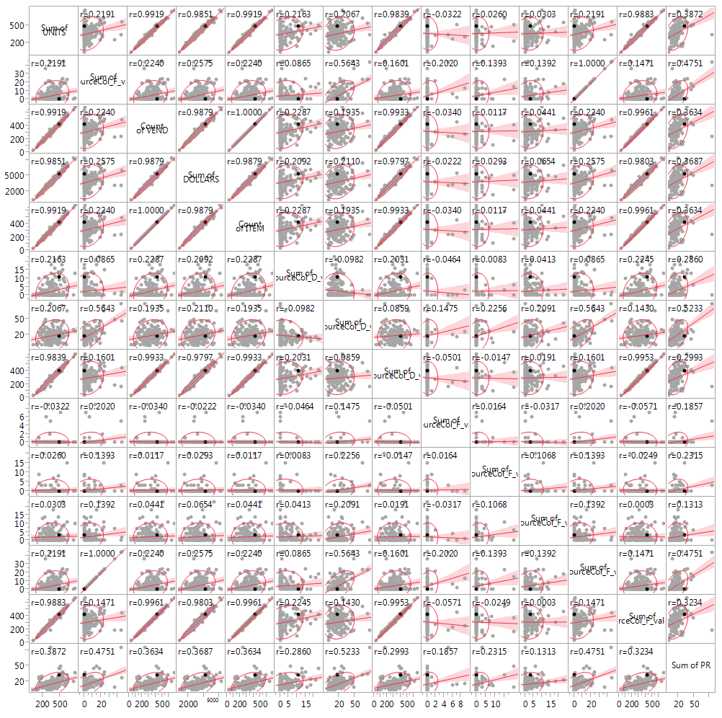
Correlations

Slide 3
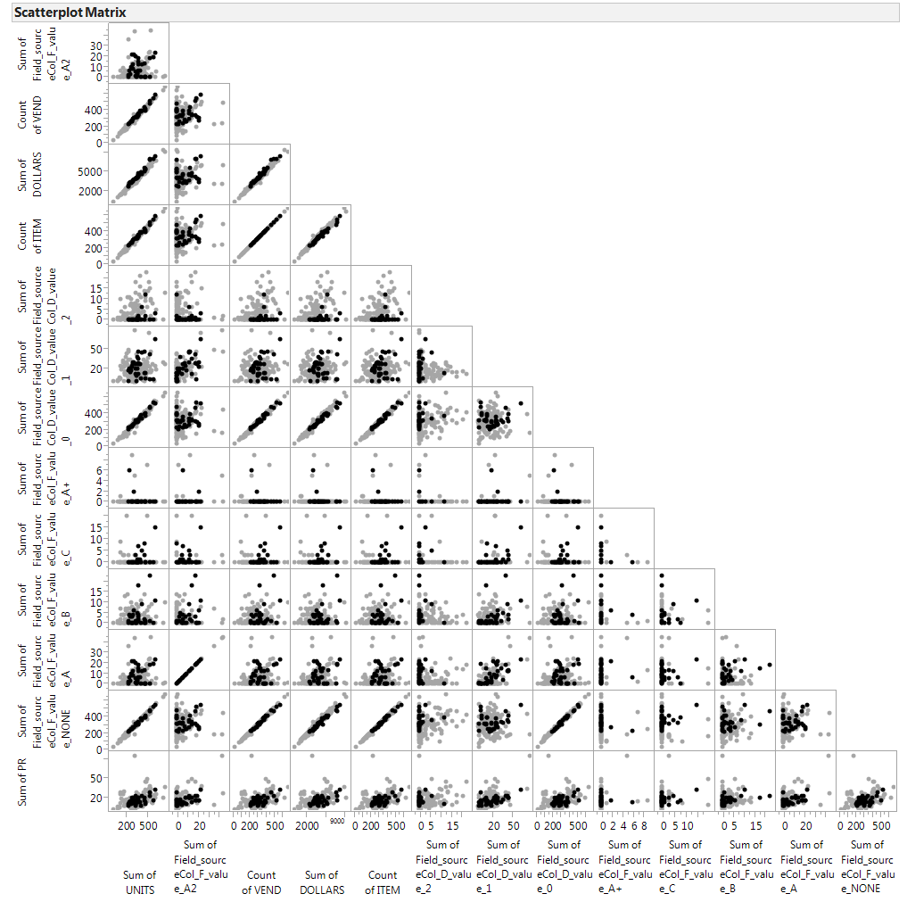

Slide 4
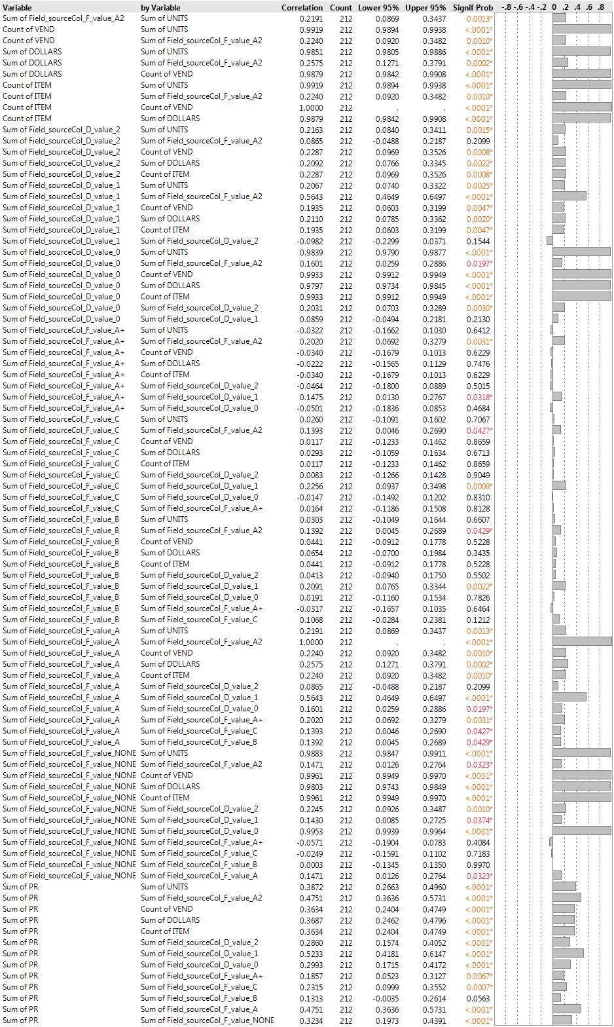
Correlations

Slide 5
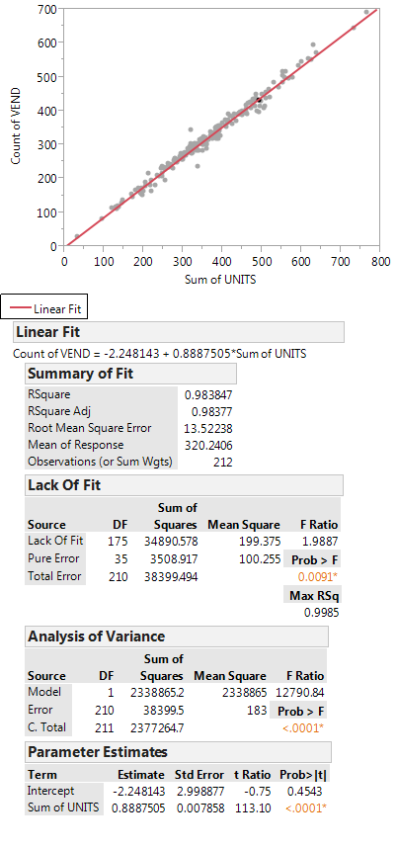
Vendor count vs sum of units

Slide 6
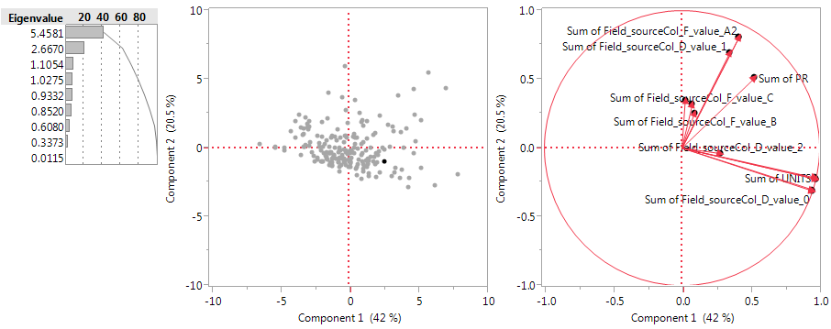
PCA

Slide 7
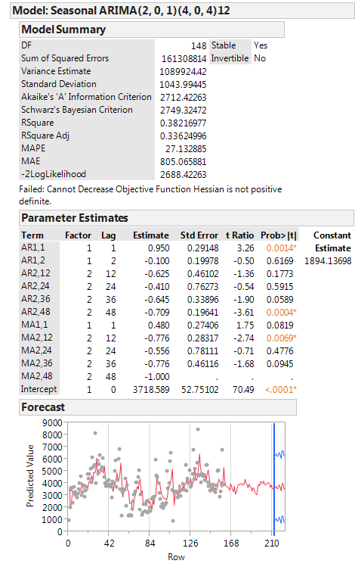
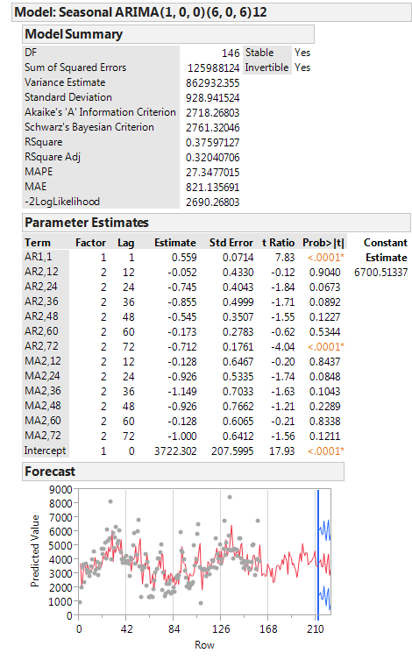
Arima models Using JMP (left off last year), would need to figure out a) what model parameters are b) how to plot last year c) how to compare model prediction and actual

